Slide 1
Activity recognition from videos (Szeliski 8.4, 12.6.4)
Michael S. Ryoo

Slide 2
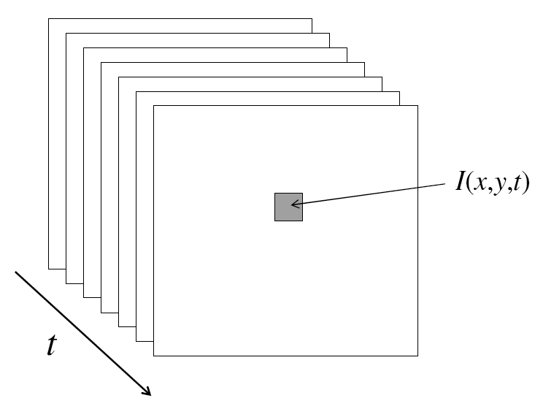
Video
A video is a sequence of frames captured over time
Now our image data is a function of space (x, y) and time (t)

Slide 3
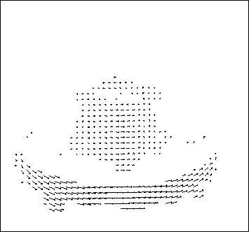
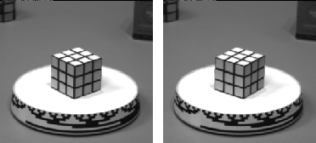
Motion field
The motion field is the projection of the 3D scene motion into the image

Slide 4
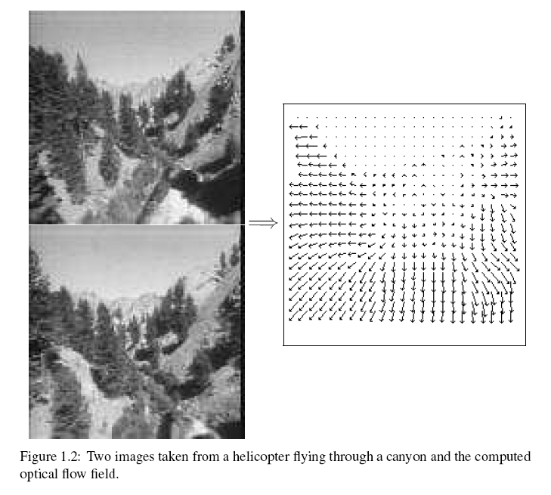
Motion field + camera motion
Length of flow vectors inversely proportional to depth Z of 3d point
points closer to the camera move more quickly across the image plane
Figure from Michael Black, Ph.D. Thesis

Slide 5


Problem definition: optical flow
How to estimate pixel motion from image H to image I?
Solve pixel correspondence problem
given a pixel in H, look for nearby pixels of the same color in I
Key assumptions
color constancy: a point in H looks the same in I
For grayscale images, this is brightness constancy
small motion: points do not move very far
This is called the optical flow problem
Steve Seitz

Slide 6


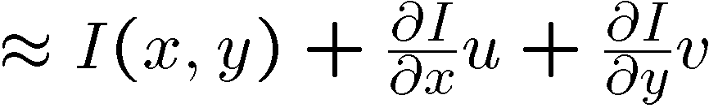
Optical flow constraints (grayscale images)
Let’s look at these constraints more closely
brightness constancy: Q: what’s the equation?
small motion:
Steve Seitz

Slide 7
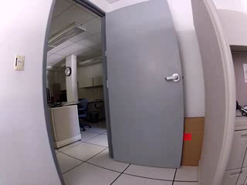
7

Slide 8

Human activity recognition
Automated understanding of videos
Labeling of events by humans in a given video
Automated algorithms generating semantic labels
Person_1 – approaches and pats Cat
Person_1 – opens Trash_bin
Person_1 – puts Cat into Trash_bin and walks away
8

Slide 9
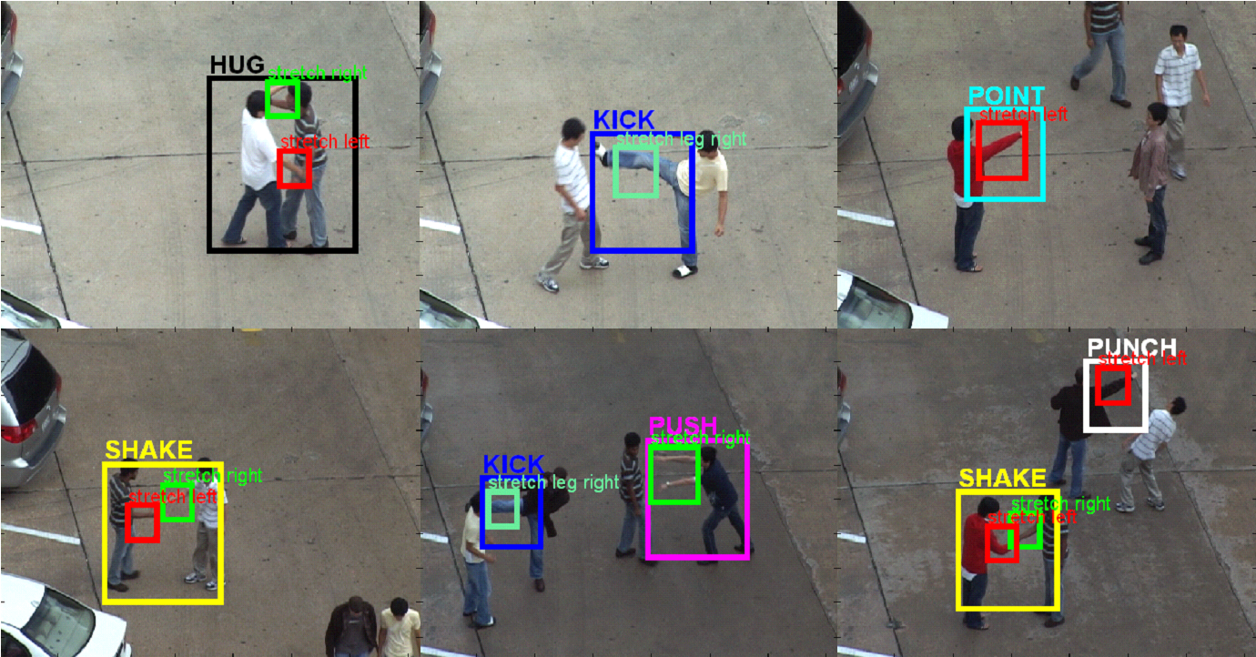
Human activity recognition
Detecting interaction-level human activities
Multiple actors, pedestrians, weather changes, …
Ryoo & Aggarwal, ICCV 2009
9

Slide 10
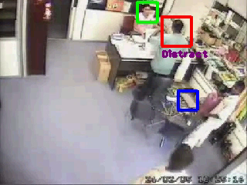
Group activity recognition
Group stealing
Real video from a CCTV in Malaysia
A group of thieves steal a laptop by distracting the owner
Thieves
Owners
Laptop
Ryoo & Aggarwal, IJCV 2011
10

Slide 11





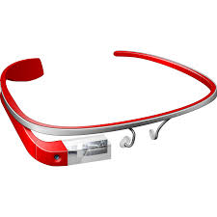
Why video analysis?
Data:
~2.5 Billion new images / month
TV-channels recorded since 60’s
~5K image uploads every min.
>34K hours of video upload every day
~30M surveillance cameras in US => ~700K video hours/day
And even more with future wearable devices
Notes:
Image and video data is exploding (cheap cameras, easy storage and sharing)

Slide 12
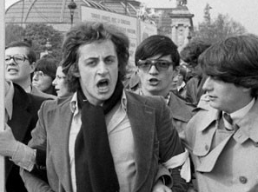
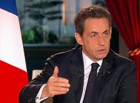
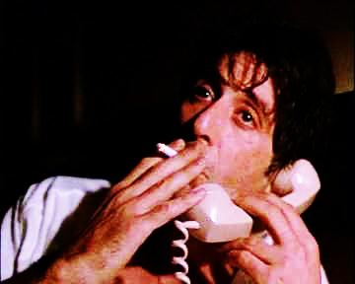
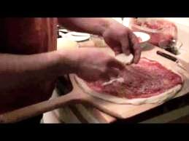
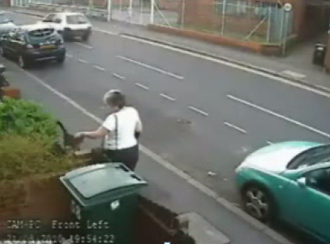
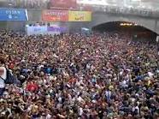
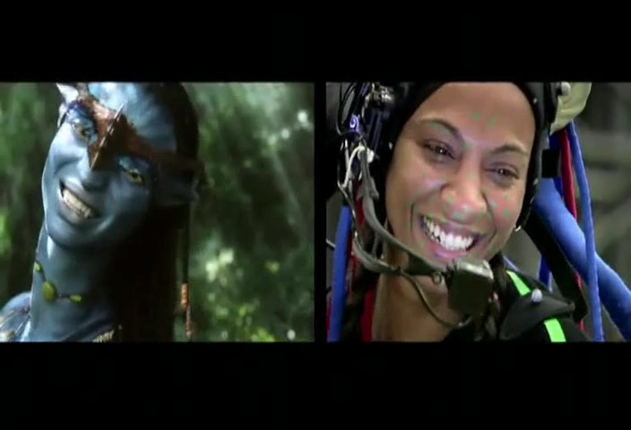
Why video analysis?
Applications:
First appearance of N. Sarkozy on TV
Sociology research: Influence of character smoking in movies
Education: How do I make a pizza?
Where is my cat?
Predicting crowd behavior Counting people
Motion capture and animation

Slide 13
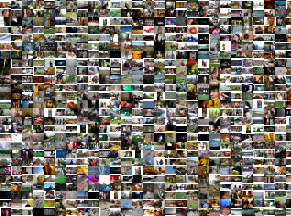
Why video analysis?
Applications:
Unconstrained video search

Slide 14
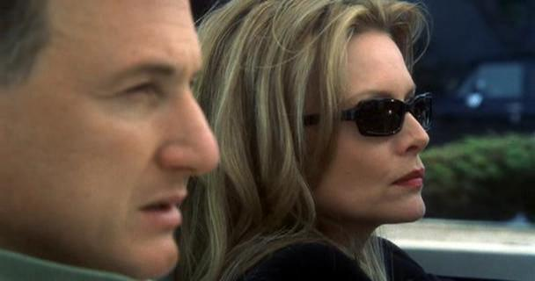
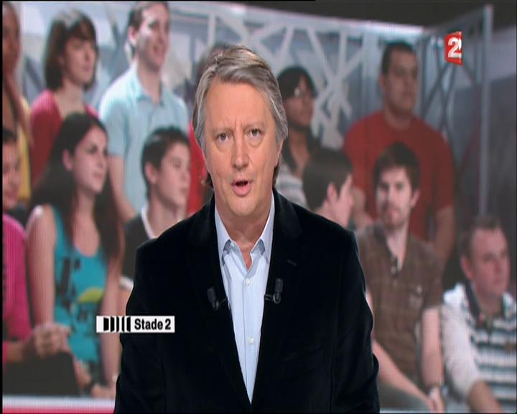
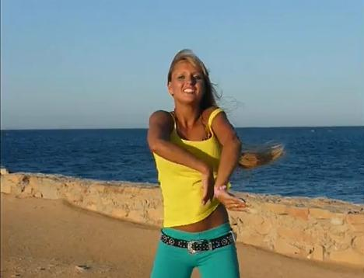
Why human activities?
How many person-pixels are in the video?
Movies
TV
YouTube

Slide 15

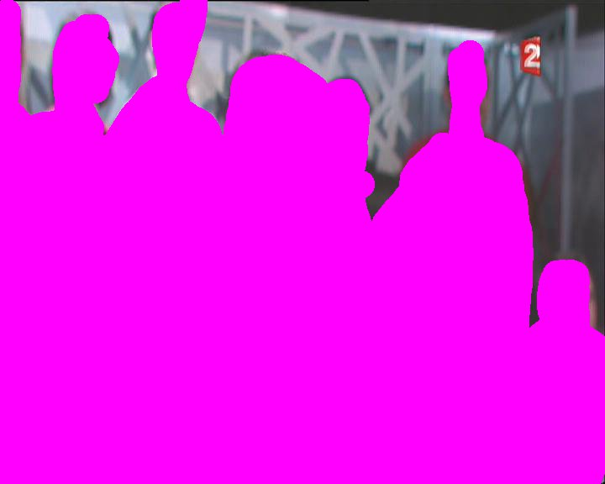
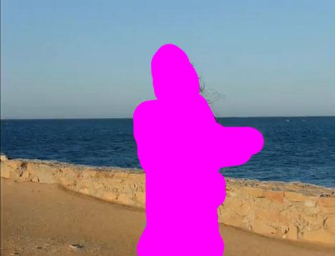
Why human activities?
How many person-pixels are in the video?
35%
34%
Movies
TV
40%
YouTube

Slide 16
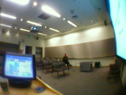

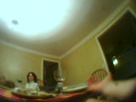
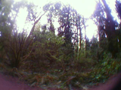
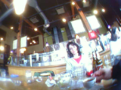
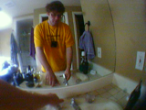
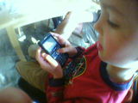
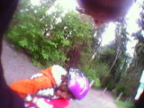
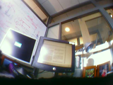
How many person pixels in our daily life?
Wearable camera data: Microsoft SenseCam dataset
Notes:
We have lots of data and many potential applications, - we have a job to do here

Slide 17
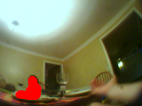
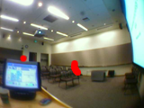

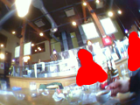
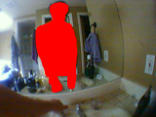

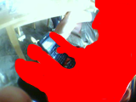
How many person pixels in our daily life?
Wearable camera data: Microsoft SenseCam dataset
~4%
Notes:
We have lots of data and many potential applications, - we have a job to do here

Slide 18
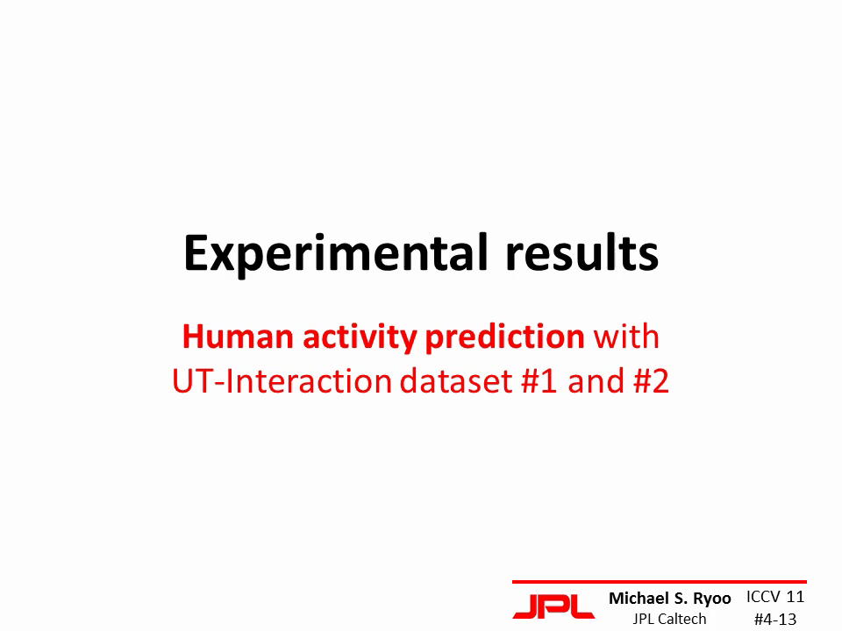
18

Slide 19
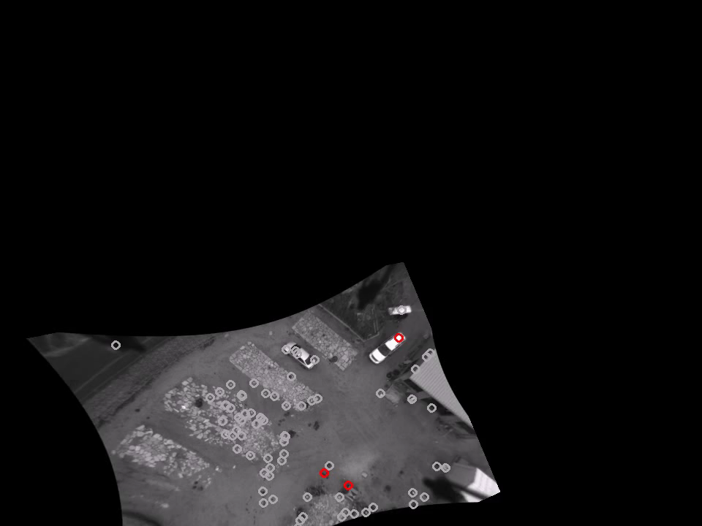
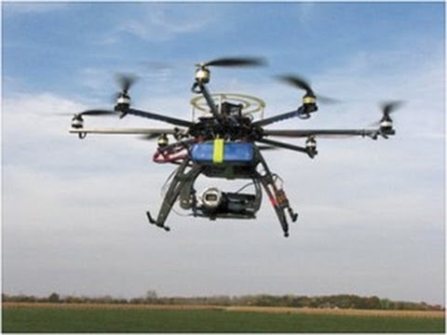
Aerial video analysis
Recognition of human activities from UAVs
Iwashita⁺, Ryoo⁺ et al. BMVC 2013
19

Slide 20


(Object) classification framework
Image data
Semantic labels
Representation
Feature extraction
Human 0.9 Not-human 0.1
Classifier
n-D data (e.g., n = 320*240)
s labels (e.g., s = 2)
k-D vector (e.g., 1000)

Slide 21




Recognition with gradients
Histogram-of-gradients (HOG) representation
Decision boundary
human
?
Non-human

Slide 22
(Object) classification framework
Image data
Semantic labels
Representation
Feature extraction
Human 0.9 Not-human 0.1
Classifier
n-D data (e.g., n = 320*240)
s labels (e.g., s = 2)
k-D vector (e.g., 1000)

Slide 23
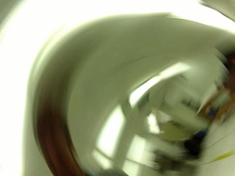
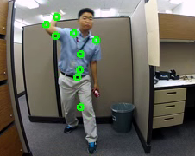
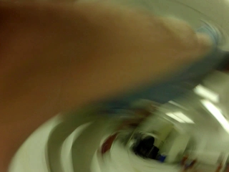
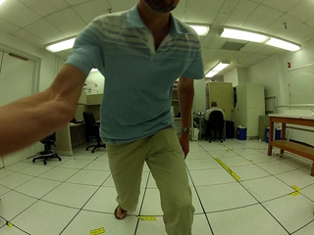
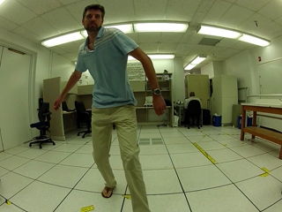
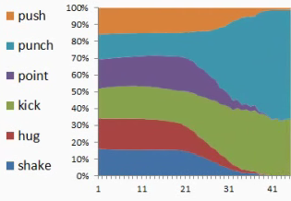
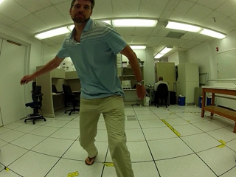
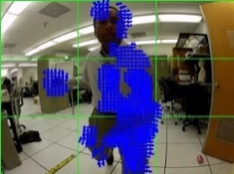
Video classification framework
Video data
Semantic labels
Representation
Feature extraction
Classifier
n*m-D data (e.g., n = 320*240, m = 1000 frames)
s labels (e.g., s = 6)
k-D vector (e.g., 1000)

Slide 24
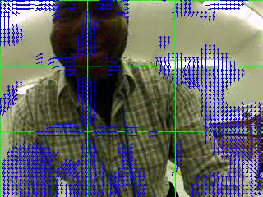
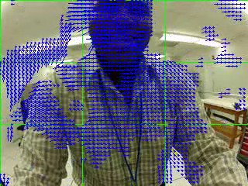
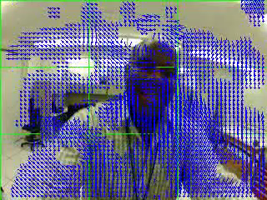
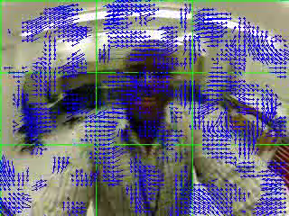






Video features (1)
Global motion descriptors: histogram of optical flows
Camera motion caused by human (e.g., shaking, hugging,…)
Optical flows
…
Global descriptors
3*3*8-D vector
Visual words
Clustering of descriptors
…
Type = 31
Type = 28
Type = 6
24

Slide 25








Video features (2)
Local motion descriptors: 3-D XYT SIFT
Detailed movements humans (e.g., arm pointing, throwing,…)
Local descriptors
Visual words
15*15*15-D
Interest points
25

Slide 26

Basic classification framework
Bag-of-words: ignores feature locations
Punching
?
Video
time
Global features
Not punching
Histogram of visual words
Features
Local features
Feature space (e.g., 1600-D)
26

Slide 27






Activity detection
Search for the particular time interval
<starting time, ending time>
Video segment containing the activity
Hugging
Pushing
Input: continuous video stream
Punching
Shaking hands
27

Slide 28








Activity detection by classification
Binary classifier
Sliding window technique
Classify all possible time intervals
Push/not-push Classifier
No, not a push.
Yes, a push.
Pushing
28

Slide 29














Activity Recognition with postures
Hierarchical activity recognition
Interaction:
Person
“pushed” by
Person
in time interval <4, 20>
Interaction
Action
Sequence of features
Features
Numerical status of a body part
Tracking
Estimates locations of human body parts
Action recognition
<1,20> : Facing right
<1,20> : Arm staying <1,20> : Leg staying
<1,20> : Facing left
<4,20> : Arm stretching <1,20> : Leg staying
Features from each frame
1 : Arm withdrawn 8 : Arm withdrawn 13 : Arm withdrawn
1 : Arm withdrawn 8 : Arm somewhat stretched 13 : Arm fully stretched
Body-part tracking
Input sequences
29

Slide 30


Activity Recognition with video features
Activity recognition
Activity:
“Shaking” occurred
Activity recognition
Decision boundary
Activity representation
A set of local spatio-temporal features
Features
Information in local video patches with salient movements
Spatio-temporal features
Videos as 3-D XYT volumes
Decision boundary for histogram of video patches (i.e., space-time features)
Input sequences
30

Slide 31




History
Johansson’s experiments [Johansson 1973]
Time
1973
1992
Tennis action recognition [Yamato et al. 1992]
1995
American sign language (ASL) recognition [Starner and Pentland 1995]

Slide 32




History
3-D posture-based recognition [Gavrila and L. Davis1995]
Time
Motion history images [J. Davis, Bobick 1997]
1995
1997
2000
Human-human interactions [Oliver, Rosario, Pentland 2000]

Slide 33








History
Far-field action recognition [Efros, Berg, Mori, Malik 2003]
Time
KTH
Local spatio-temporal features [Laptev 2005]
Hollywood
2003
Movies [Laptev 2008]
2005
2008
2009
UT-Interaction
Spatio-temporal relations [Ryoo and Aggarwal 2009]

Slide 34






Videos for activity recognition
Recognition from various types of videos
Surveillance videos
Movies and user videos
Sports videos
Static cameras
Side or top view
Simple background
Moving cameras
Side view
Dynamic
Video segments
Side or top view
Objects/people
Weizmann dataset
Hollywood dataset
UCF-Sports dataset
UT-Interaction dataset
TRECVID dataset
UCF101 dataset
34

Slide 35





First-person videos
Images/videos taken from a wearable camera
Examples:
Camera’s field of view
Conventional 3rd-person videos
1st-person videos
35

Slide 36





Dimension 1: levels of human activities
There are various types of activities
The ultimate goal is to make computers recognize all of them reliably.
human-object interactions
group activities
gestures
actions
interactions
Levels of human activities
36

Slide 37


Dimension 2: structure in activities
Different levels of structure complexity (temporal/spatial)
Complexity of structure in human activities
37

Slide 38
(Final) assignment

Slide 39



JPL-Interaction dataset
Videos of activities from the viewpoint of a ‘robot’
http://michaelryoo.com/jpl-interaction.html
Download the segmented version
Do activity ‘classification’
Each video segment contains one activity
Use set1~6 for the training and set7~12 for the testing

Slide 40

Feature descriptors - HOG
Extract ‘simplified HOG’ per frame
Divide the frame into 5*5 spatial regions
9 different gradient orientations
Unsigned gradient ([0,20], [20,40],…, [160,180])
Resulting feature vector dim: 5*5*9
Also try L1 normalization of the entire vector
For a given feature vector x = [x₁, …, x_{n}], L1-norm(x) = x / |x|₁ where

Slide 41
Feature descriptors - HOF
Extract ‘histogram of optical flows’ (HOF)
Obtain optical flows using a library (e.g., OpenCV)
Divide the frame into 5*5 spatial regions
8 different optical flow orientations
Signed orientations ([0,45],…,[315-360])
Create a histogram per frame
Resulting feature vector dim: 5*5*8
Also try L1 normalization of the entire vector

Slide 42
Activity classification
Build 4 different types of feature representations per video
Mean HOG value
Mean HOF value
Bag-of-visual-words with HOG
Bag-of-visual-words with HOF
Try different ‘# of visual words’, including 25, 50, …
Do classification with …

